Slide 1


Credit score MATTERS TO GET A Career IN United states
Texas Southern University
Business & Professional Communications
Andrea Ivory
Professor Shera Carter
July 15, 2021

Slide 2

Introduction
Applying for a job requires the use of the best available information to increase the chances of getting a job.
Financial handling and management information is part of significant information which can increase competitive advantage for the applicant.
The credit score gives a comprehensive look into the life of the applicant relating to money handling and management habits.
Credit scores give significant additional information about the job applicant which makes it a fair way of evaluating candidates to the employers and employees.

Slide 3
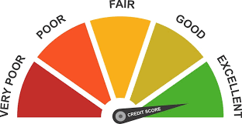
Credit Score
Companies perform background checks on their potential employees using the available background information.
The credit score may not be available to the employer but they can also request a credit history report.
The credit report includes credit card information, credit history, history of payments as well as balances which are examined in credit score.
A good or a poor credit score indicates whether the individual is a good or bad credit risk.

Slide 4
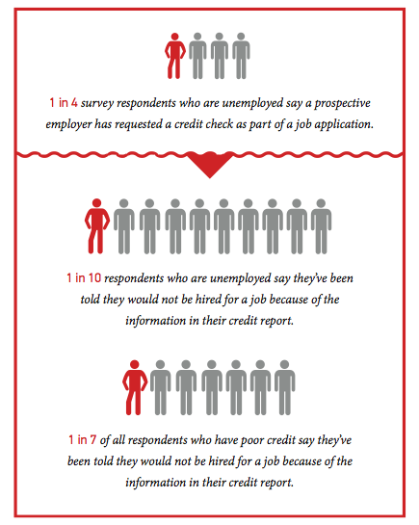
Significance of credit score to the employer
The employer looks at the patterns of handling and managing money.
Positive and negative habits in managing money can increase or decrease applicant potential employee.
Late and early payments from the employee are an indicator of how the potential employee lives up to agreements as well as how organized they are.
The credit report gives significant insights on possible financial distress which can contribute to fraud and theft.
Money handling habits show how responsible an individual can be with an organization's money or customer information.

Slide 5
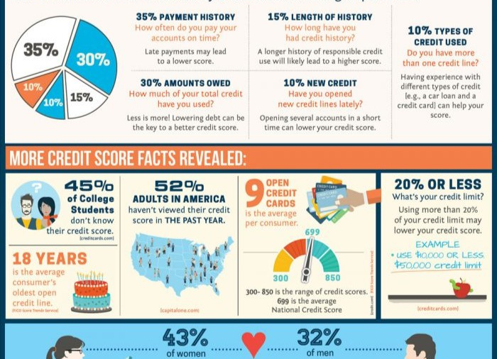
Legal rights
The employer is required to notify and acquire written permission from the applicant before accessing the credit reports.
An employer is required to send a “pre-adverse notice” to the applicant when rejected entirely based on the credit score.
An individual should be given a chance to explain the red flags which may possibly arise from the report as well as the possibility of false information.

Slide 6
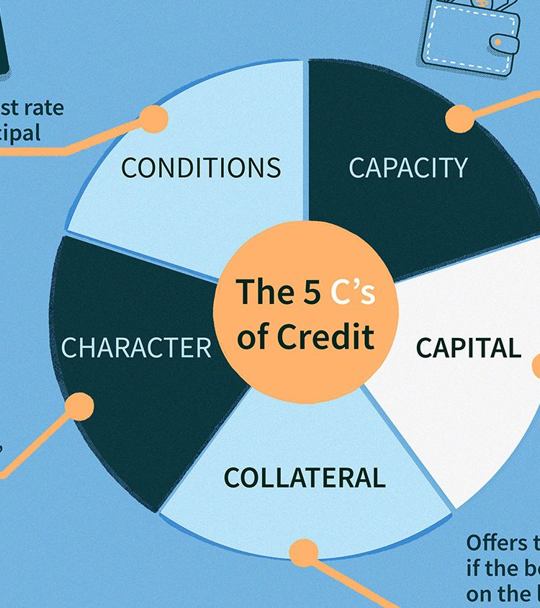
Conclusion
Credit scores give significant information to employers about the potential employee’s management and handling of finances.
A good credit score indicates how good the candidate would be to the company and the customers.
A credit score shows the financial situation of an individual and the possibility of fraud and embezzlement.
Getting a job in an organization which checks credit score also ensure one work around people who are responsible and live up to their agreements.

